Slide 1


3rd Capstone Project: Machine Learning model using Python
By Mikko De Torres

Slide 2
Topics
Dataset
Robot Inverse Kinematics
ML Model
Random Forest Regression

Slide 3
Robot Inverse Kinematics

Slide 4
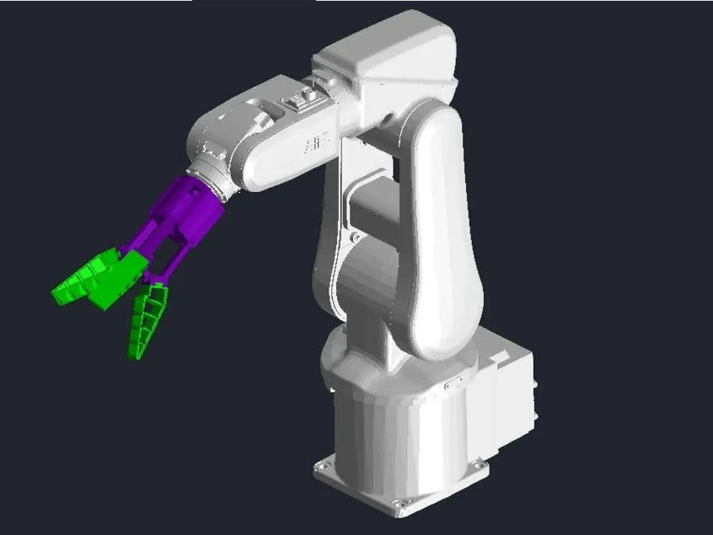
Context
Inverse kinematics is a challenging problem in robotics, but it is vital for determining the joint angles required to position a robot's end-effector accurately. In contrast, direct kinematics, which involves calculating the end-effector position based on joint angles, is relatively simpler. To address this, I have obtained a dataset of direct kinematics for an IRB 120 robotic manipulator. This dataset provides us with the joint coordinates and corresponding tool coordinates (x, y, z) for the robot. By leveraging this dataset, we can apply machine learning techniques to build models that predict the joint variables needed for inverse kinematics, allowing us to efficiently determine the precise joint angles for positioning the robot's end-effector.
Printables.com. (n.d.). Gripper for ABB IRB120 [Digital image]. Retrieved from https://www.printables.com/model/57316-gripper-for-abb-irb120

Slide 5
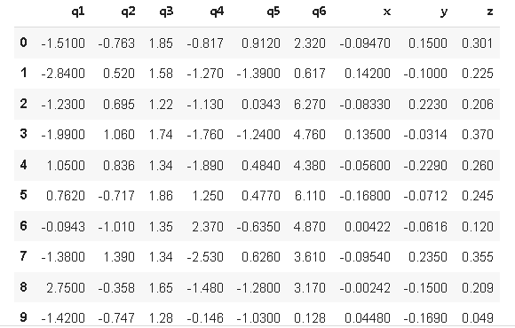
Content
The dataset was created by randomly generating joint values within the permissible ranges for each of the six joints of the robotic manipulator, following the guidelines provided in the "IRB 120 Product Manual" by ABB. These joint values, expressed in radians, were used in direct kinematic equations to calculate the corresponding x, y, and z coordinates. Each pair of joint and coordinate vectors represents a single data point, and the entire dataset comprises 15,000 such data points generated using this approach.

Slide 6
References
Citations
Baressi Šegota S, Anđelić N, Mrzljak V, Lorencin I, Kuric I, Car Z. Utilization of multilayer perceptron for determining the inverse kinematics of an industrial robotic manipulator. International Journal of Advanced Robotic Systems. 2021 Aug 13;18(4):1729881420925283.
Car Z, Baressi Šegota S, Anđelić N, Lorencin I, Musulin J, Štifanić D, Mrzljak V. Determining Inverse Kinematics of a Serial Robotic Manipulator Through the Use of Genetic Programming Algorithm. 8th International Congress of the Serbian Society of Mechanics. 2021 July 21.
Acknowledgements
This research was (partly) supported by the CEEPUS network CIII-HR-0108, European Regional Development Fund under the grant KK.01.1.1.01.0009 (DATACROSS), project CEKOM under the grant KK.01.2.2.03.0004, CEI project “COVIDAi” (305.6019-20), University of Rijeka scientific grant uniri-tehnic-18-275-1447.

Slide 7
Random Forrest Regression

Slide 8
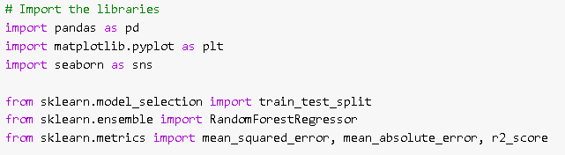
Import the Libraries
These are the libraries needed for Random Forrest Regression of the dataset.

Slide 9
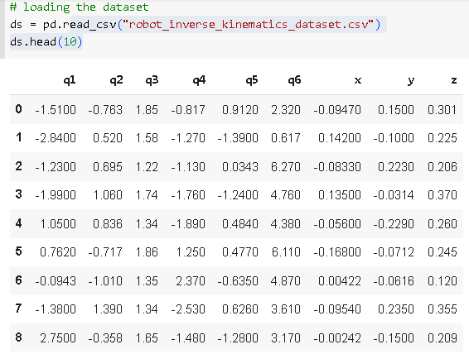
Loading the Dataset
The shape of the dataset is 15000 x 9.
No incomplete and duplicate rows. Already ready for data splitting.

Slide 10

Splitting the Data
The joint variables (q1,q2,q3,q4,q5 and q6) will be the independent variable X.
The components of position vector (x, y and z) will be the independent variable y.

Slide 11
Choosing the Model
I chose Random Forest Regression because it is commonly used in predicting the inverse kinematics of a robot manipulator. As well as is an ensemble learning method that combines multiple decision trees to make predictions. It can handle both numerical and categorical data and is robust against overfitting.

Slide 12
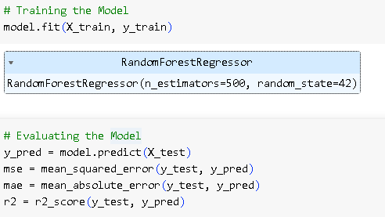
Training and Evaluating the model
Training the Model:
Fit the RandomForestRegressor model to the training data using the fit() method.
Provide the input features (joint variables) as X_train and the target variable (position vector components) as y_train.

Slide 13
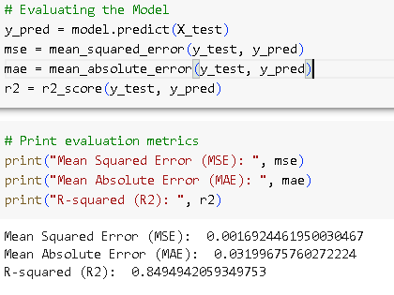
Training and Evaluating the model
Evaluating the Model:
Use the trained model to make predictions on the testing set using the predict() method.
Assess the performance of the model by calculating regression evaluation metrics such as mean squared error (MSE), mean absolute error (MAE), or R-squared.
Compare the predicted position vector components (y_pred) with the actual values (y_test) to evaluate the model's accuracy and performance.

Slide 14
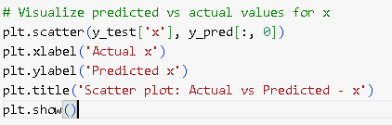
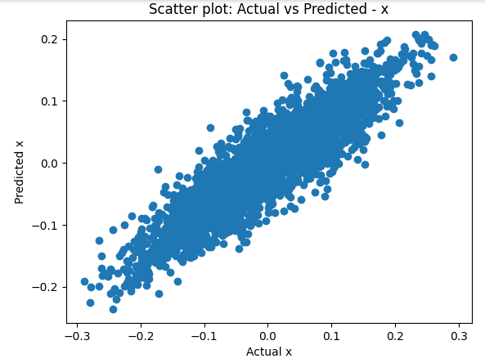
Visualize using Scatter Plot

Slide 15
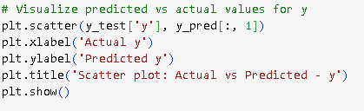
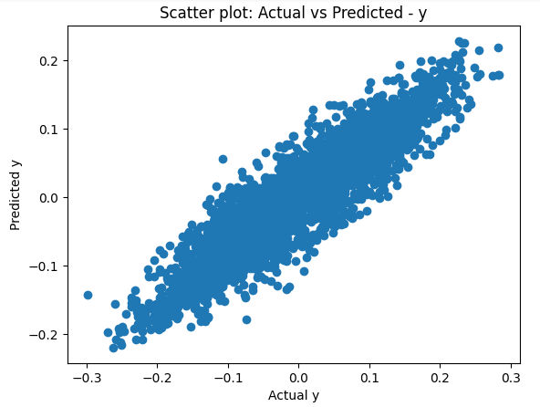
Visualize using Scatter Plot

Slide 16
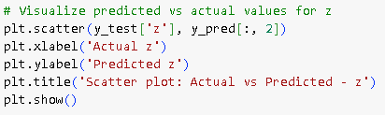
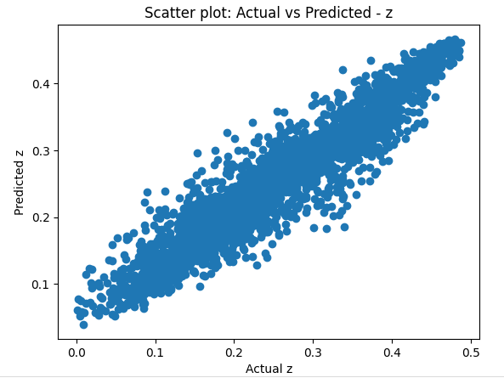
Visualize using Scatter Plot

Slide 17
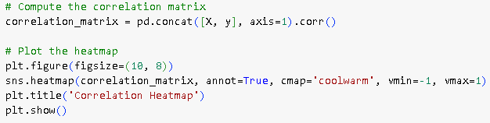
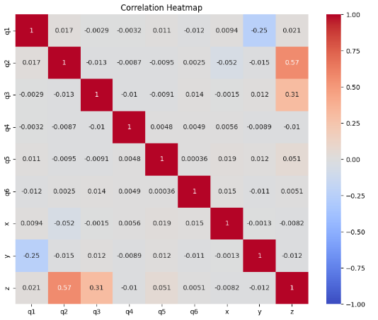
Visualization using Heatmap

Slide 18
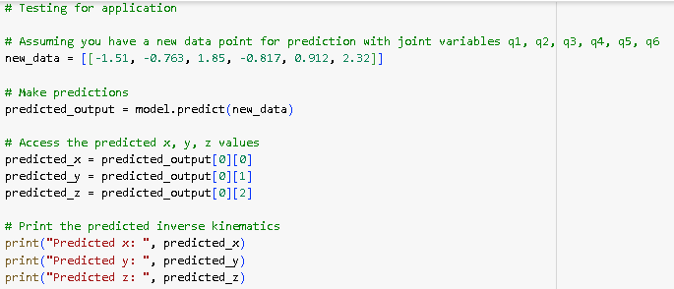

Testing for Application

Slide 19
THANK YOU!

